Slide 1
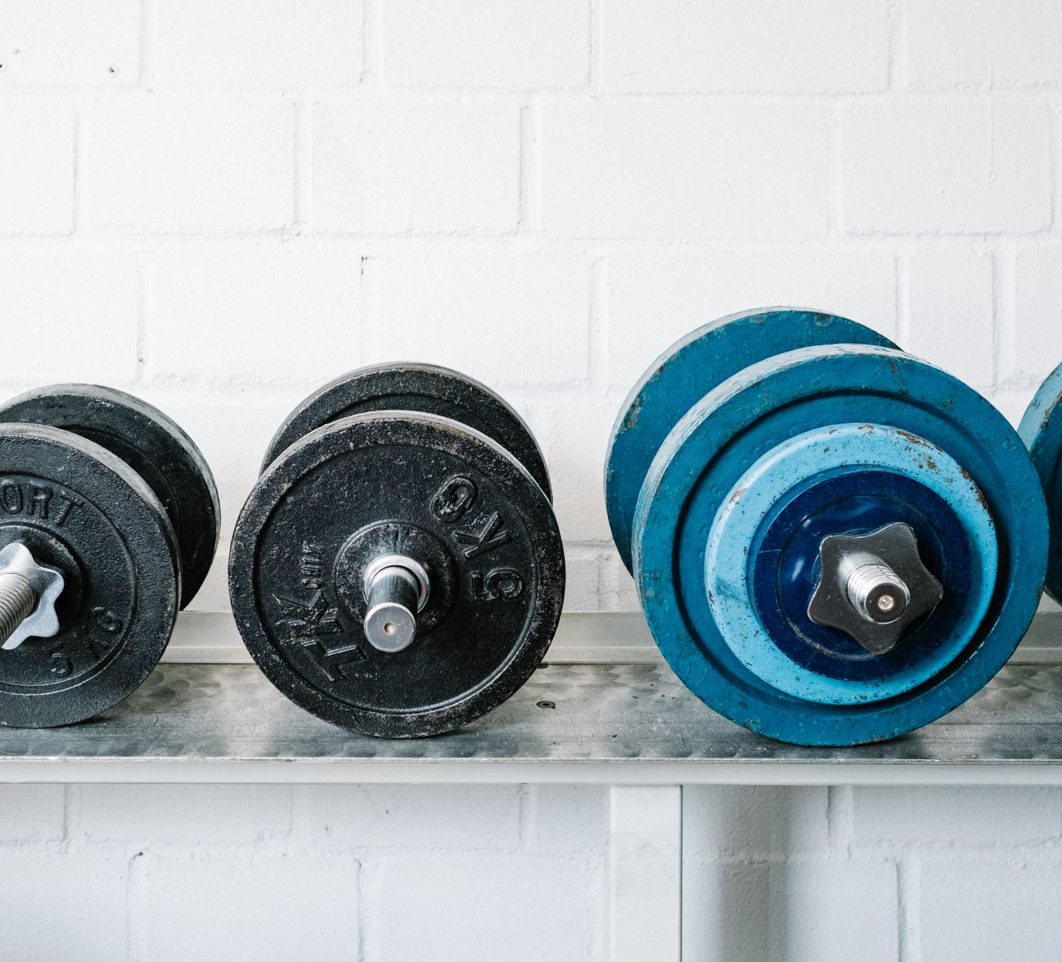
Fit Lifestyle Application
Shane Crotty (G00357979)
Atlantic Technological University
Software and Electronic Engineering

Slide 2
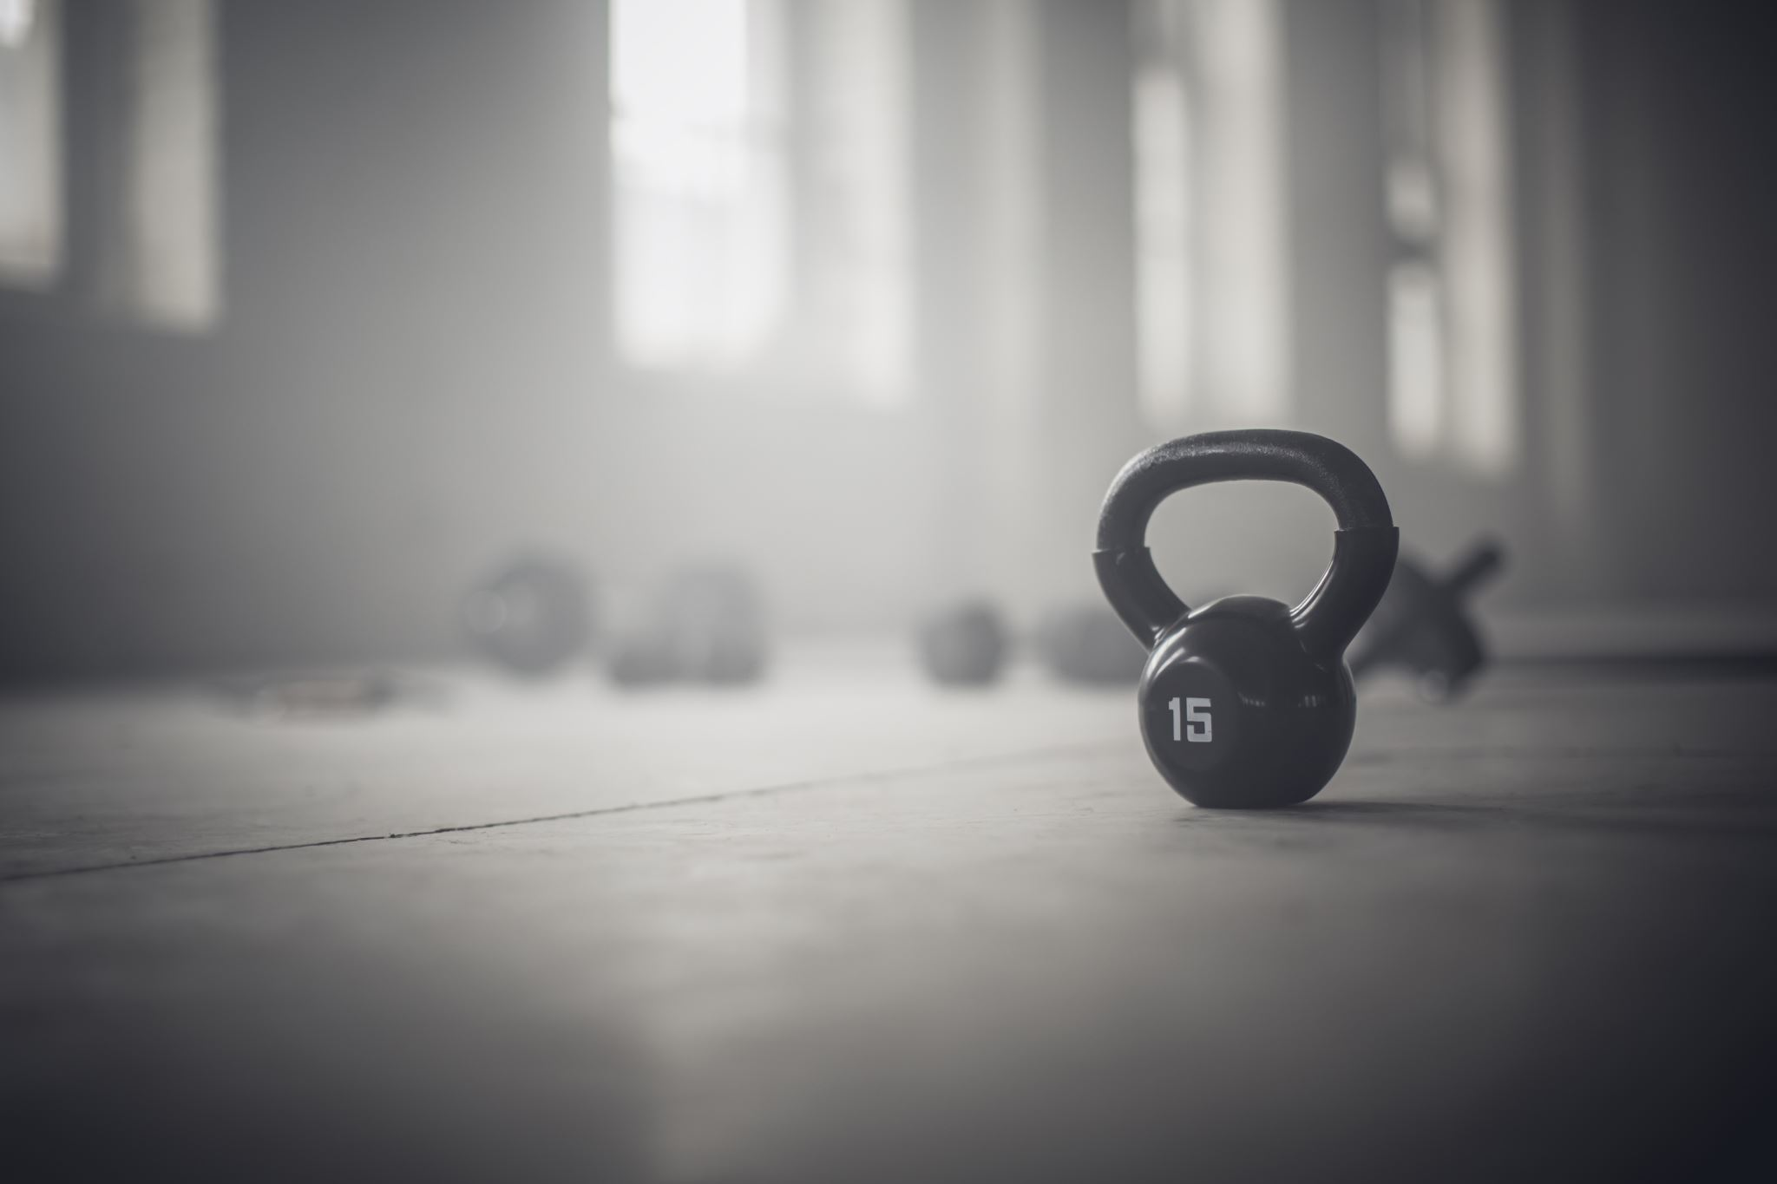
Why did I decide to do this Project?
I have a great interest in Fitness and Nutrition.
I have experience with doing a meal plan and tracking my food.
I’ve had issues in the past that this mobile-application would help.
I wanted to learn how to design and create a mobile-application.
I think it’s a great skill to have and want to continue to learn about.

Slide 3
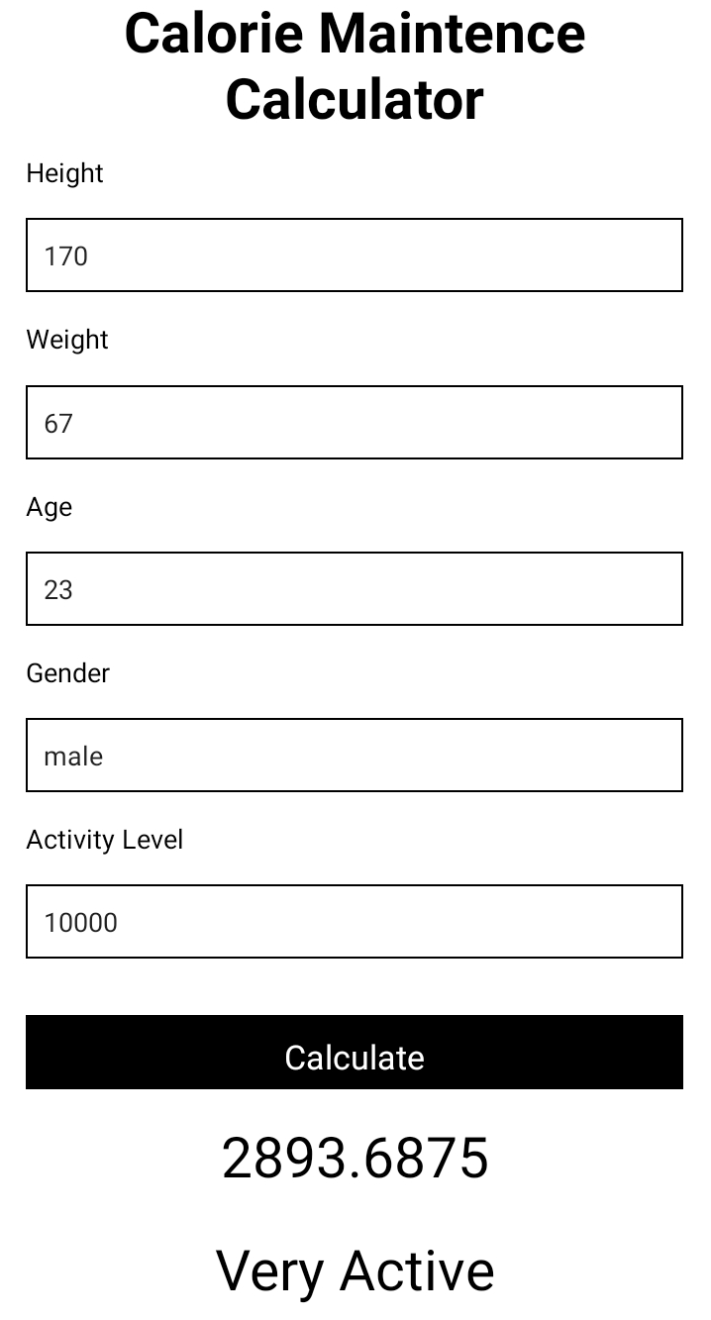
Calorie Maintenance Calculator
Total Daily Energy Expenditure (TDEE) .
Maintain current weight on Maintenance calories.
Basal metabolic rate (BMR).
Harris-Benedict Formula: 66+(13.7 x weight(kg)) + (5 x height(cm)) – (6.8 x age)

Slide 4
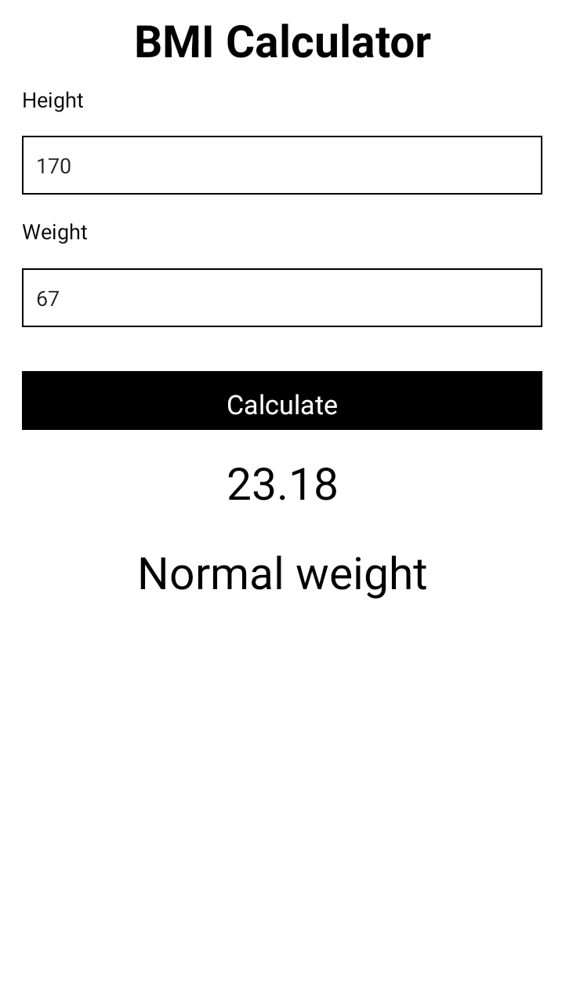
Body Mass Index (BMI) Calculator
BMI = kg/m^2
This helps you check if you are at a healthy weight for your height
Below 18.5 Underweight
18.5 – 24.9 Healthy
25.0 – 29.9 Overweight
30 and above Obese

Slide 5
React Native and Expo
With Expo, you can build and deploy React native apps for both iOS and Android.
Expo is a framework and platform for React applications.
Expo CLI, QR-Code
Visual Studio, JavaScript.
Expo.io.
Download Expo Go onto your mobile phone.

Slide 6
Conclusion
App works the way I wanted.
The Calorie Maintenance calculator works correctly.
The BMI Calculator worked correctly.
The App is useful in the fitness industry.

